Slide 1
CS 570: Data Structures
Collections Framework:
Lists

Slide 2
Chapter Objectives
The List interface
Writing an array-based implementation of List
Linked list data structures:
Singly-linked
Doubly-linked
Circular
Implementing the List interface as a linked list
The Iterator interface
Low priority for CS 570
The Java Collections framework (hierarchy)
Low priority for CS 570

Slide 3
Introduction
A list is a collection of elements, each with a position or index
Iterators facilitate sequential access to lists
Classes ArrayList, Vector, and LinkedList are subclasses of abstract class AbstractList and implement the List interface

Slide 4
List Interface and ArrayList Class
An array is an indexed structure
In an indexed structure,
elements may be accessed in any order using subscript values
elements can be accessed in sequence using a loop that increments the subscript
With the Java Array object, you cannot
increase or decrease its length (length is fixed)
add an element at a specified position without shifting elements to make room
remove an element at a specified position and keep the elements contiguous without shifting elements to fill in the gap

Slide 5
List Interface and ArrayList Class (cont.)
Java provides a List interface as part of its API java.util
Classes that implement the List interface provide the functionality of an indexed data structure and offer many more operations
A sample of the operations:
Obtain an element at a specified position
Replace an element at a specified position
Find a specified target value
Add an element at either end
Remove an element from either end
Insert or remove an element at any position
Traverse the list structure without managing a subscript
All classes introduced in this chapter support these operations, but they do not support them with the same degree of efficiency

Slide 6
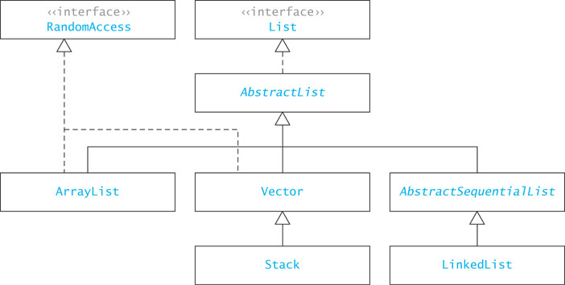
java.util.List Interface and its Implementers
Notes:
randomAccess: marker interface (no methods)

Slide 7
ArrayList Class
The simplest class that implements the List interface
An improvement over an array object
Use when:
you will be adding new elements to the end of a list
you need to access elements quickly in any order

Slide 8
List Interface and ArrayList Class
8
Unlike the Array data structure, classes that implement the List interface cannot store primitive types
Classes must store values as objects
This requires you to wrap primitive types, such an int and double in object wrappers, such as Integer and Double

Slide 9
ArrayList Class (cont.)
To declare a List “object” whose elements will reference String objects:
List<String> myList = new ArrayList<String>();
The initial List is empty and has a default initial capacity of 10 elements
To add strings to the list,
myList.add("Bashful");
myList.add("Awful");
myList.add("Jumpy");
myList.add("Happy");

Slide 10
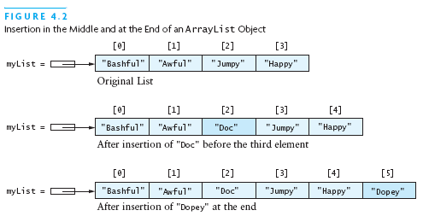
ArrayList Class (cont.)
Adding an element with subscript 2:
myList.add(2, "Doc");
Notice that the subscripts of "Jumpy" and "Happy" have changed from [2],[3] to [3],[4]
Notes:
add: override or ovderload? - Overload

Slide 11
ArrayList Class (cont.)
When no subscript is specified, an element is added at the end of the list:
myList.add("Dopey");

Slide 12

ArrayList Class (cont.)
Removing an element:
myList.remove(1);
The strings referenced by [2] to [5] have changed to [1] to [4]

Slide 13

ArrayList Class (cont.)
You may also replace an element:
myList.set(2, "Sneezy");

Slide 14
ArrayList Class (cont.)
You cannot access an element using a bracket index as you can with arrays (array[1])
Instead, you must use the get() method:
String dwarf = myList.get(2);
The value of dwarf becomes "Sneezy"

Slide 15
ArrayList Class (cont.)
You can also search an ArrayList:
myList.indexOf("Sneezy");
This returns 2 while
myList.indexOf("Jumpy");
returns -1 which indicates an unsuccessful search

Slide 16
Generic Collections
The statement
List<String> myList = new ArrayList<String>();
uses a language feature called generic collections or generics
The statement creates a List of String; only references of type String can be stored in the list
String in this statement is called a type parameter
The type parameter sets the data type of all objects stored in a collection

Slide 17
Generic Collections (cont.)
The general declaration for generic collection is
CollectionClassName<E> variable = new CollectionClassName<E>();
The <E> indicates a type parameter
Adding a noncompatible type to a generic collection will generate an error during compile time
However, primitive types will be autoboxed:
ArrayList<Integer> myList = new ArrayList<Integer>();
myList.add(new Integer(3)); // ok
myList.add(3); // also ok! 3 is automatically wrapped
in an Integer object
myList.add(new String("Hello")); // generates a type incompatability error

Slide 18
Why Use Generic Collections?
Better type-checking: catch more errors, catch them earlier
Documents intent
Avoids the need to downcast from Object

Slide 19
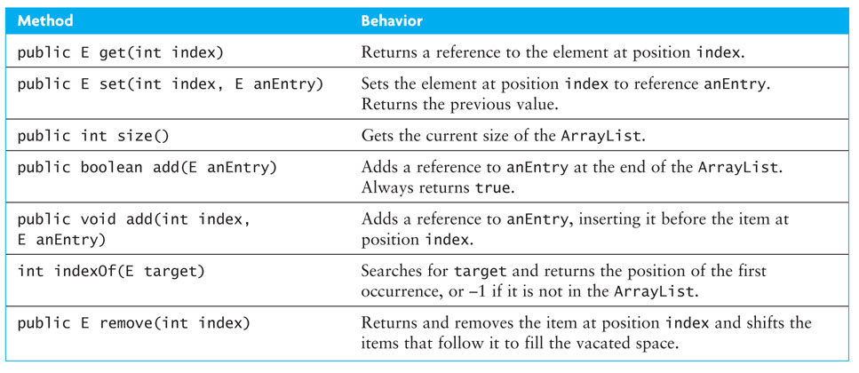
Specification of the ArrayList Class

Slide 20
Applications of ArrayList
Section 2.2

Slide 21
Example Application of ArrayList
ArrayList<Integer> someInts = new ArrayList<Integer>();
int[] nums = {5, 7, 2, 15};
for (int i = 0; i < nums.length; i++) {
someInts.add(nums[i]);
}
// Display the sum
int sum = 0;
for (int i = 0; i < someInts.size(); i++) {
sum += someInts.get(i);
}
System.out.println("sum is " + sum);

Slide 22
Phone Directory Application
public class DirectoryEntry {
String name;
String number;
}
Create a class for objects stored in the directory

Slide 23
Phone Directory Application (cont.)
public class DirectoryEntry {
String name;
String number;
}
private ArrayList<DirectoryEntry> theDirectory = new ArrayList<DirectoryEntry>();
Create the directory

Slide 24
Phone Directory Application (cont.)
Add a DirectoryEntry object
public class DirectoryEntry {
String name;
String number;
}
private ArrayList<DirectoryEntry> theDirectory = new ArrayList<DirectoryEntry>();
theDirectory.add(new DirectoryEntry("Jane Smith",
"555-1212"));

Slide 25
Phone Directory Application (cont.)
Method indexOf searches theDirectory by applying the equals method for class DirectoryEntry. Assume DirectoryEntry's equals method compares name fields.
public class DirectoryEntry {
String name;
String number;
}
private ArrayList<DirectoryEntry> theDirectory = new ArrayList<DirectoryEntry>();
theDirectory.add(new DirectoryEntry("Jane Smith",
"555-1212"));
int index = theDirectory.indexOf(new DirectoryEntry(aName,””));

Slide 26
Phone Directory Application (cont.)
…
int index = theDirectory.indexOf(new DirectoryEntry(aName, ""));
if (index != -1)
dE = theDirectory.get(index);
else
dE = null;

Slide 27
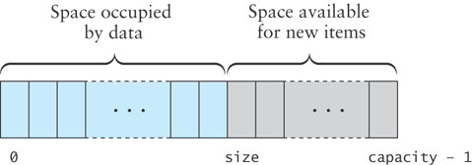
Implementing an ArrayList Class
KWArrayList: a simple implementation of ArrayList
Physical size of array indicated by data field capacity
Number of data items indicated by the data field size

Slide 28
KWArrayList Fields
import java.util.*;
/** This class implements some of the methods of the Java ArrayList class */
public class KWArrayList<E> {
// Data fields
/** The default initial capacity */
private static final int INITIAL_CAPACITY = 10;
/** The underlying data array */
private E[] theData;
/** The current size */
private int size = 0;
/** The current capacity */
private int capacity = 0;
}

Slide 29
KWArrayList Constructor
public KWArrayList () {
capacity = INITIAL_CAPACITY;
theData = (E[]) new Object[capacity];
}
This statement allocates storage for an array of type Object and then casts the array object to type E[]
Although this may cause a compiler warning, it's ok

Slide 30
Implementing ArrayList.add(E)
We will implement two add methods
One will append at the end of the list
The other will insert an item at a specified position

Slide 31
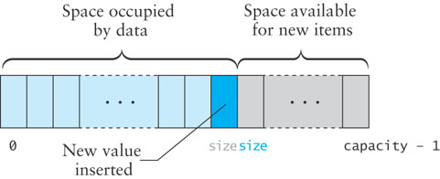
Implementing ArrayList.add(E)(cont.)
If size is less than capacity, then to append a new item
insert the new item at the position indicated by the value of size
increment the value of size
return true to indicate successful insertion
Notes:
running time? O(1) average, O(n) worst case - reallocation

Slide 32
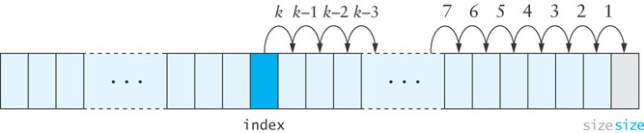
Implementing ArrayList.add(int index,E anEntry)
To insert into the middle of the array, the values at the insertion point are shifted over to make room, beginning at the end of the array and proceeding in the indicated order

Slide 33
Implementing ArrayList.add(index,E)
public void add (int index, E anEntry) {
// check bounds
if (index < 0 || index > size) {
throw new ArrayIndexOutOfBoundsException(index);
}
// Make sure there is room
if (size >= capacity) {
reallocate();
}
// shift data
for (int i = size; i > index; i--) {
theData[i] = theData[i-1];
}
// insert item
theData[index] = anEntry;
size++;
}
Notes:
RUNNING TIME? O(n)

Slide 34
set and get Methods
public E get (int index) {
if (index < 0 || index >= size) {
throw new ArrayIndexOutOfBoundsException(index);
}
return theData[index];
}
public E set (int index, E newValue) {
if (index < 0 || index >= size) {
throw new ArrayIndexOutOfBoundsException(index);
}
E oldValue = theData[index];
theData[index] = newValue;
return oldValue;
}
Notes:
RUNNING TIME? O(1)

Slide 35
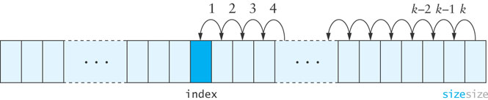
remove Method
When an item is removed, the items that follow it must be moved forward to close the gap
Begin with the item closest to the removed element and proceed in the indicated order

Slide 36
remove Method (cont.)
public E remove (int index) {
if (index < 0 || index >= size) {
throw new ArrayIndexOutOfBoundsException(index);
}
E returnValue = theData[index];
????? Fill in the blank ???????????
size--;
return returnValue;
}
Notes:
RUNNING TIME? O(n)

Slide 37
reallocate Method
Create a new array that is twice the size of the current array and then copy the contents of the new array
private void reallocate () {
capacity *= 2;
theData = Arrays.copyOf(theData, capacity);
}
Notes:
RUNNING TIME? O(n)

